Slide 1

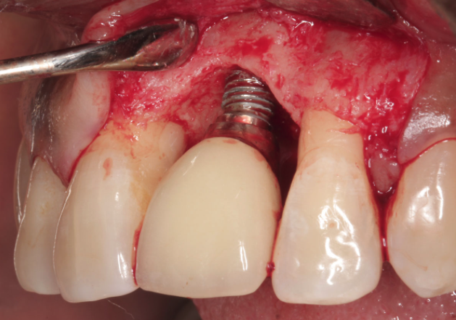
Proyecto: Whiteeth
Introduction

Slide 2
Proyecto: Whiteeth
Introduction
Goals:
Predict infections in the mouth to prevent them.
The main objective of point 3 is to end or prevent epidemics of communicable and non-communicable diseases by 2030.

